Slide 1
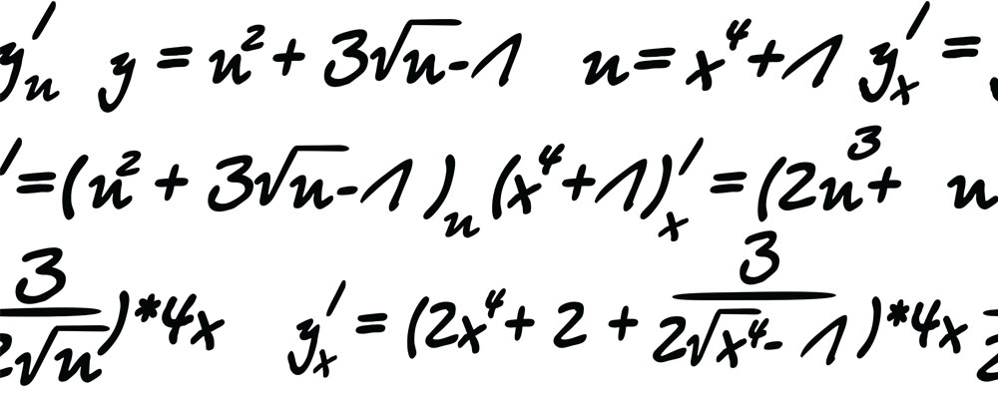

My Algebra
Interactive Notebook
Name:
Class: 7 - 2
Teacher: Miss L
Term 2 Semester 1

Slide 2

Lesson Objectives
Replace variables like x and y with numbers

Slide 3
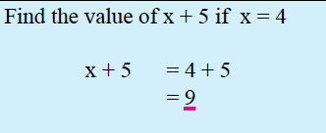
24
7
30
Topic: Algebra
Date
EQ – How do we substitute letters for numbers?
When you replace a variable such as x and y with a number
What is substitution?
Notes:
Use a sticky note to cover the x with 4. The students will be doing this for their Task bit

Slide 4
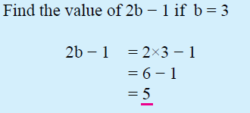
24
7
30
Topic: Algebra
Date
EQ – How do we substitute letters for numbers?
What is substitution?
When you replace a variable such as x and y with a number
Notes:
Use a sticky note to cover the x with 4. The students will be doing this for their Task bit

Slide 5



Examples
Find the value of each of the following algebraic expressions given that
x = 4 and y = 9
$$3×x$$
$$y−5$$
$$x+4$$
$$4x−y$$
$$2×y$$
$$y−x$$
$$3x+4$$
$$2y−y$$

Slide 6

Task
Complete the worksheet using your whiteboard marker and laminated square to substitute in the numbers. Then complete the colouring sheet.
Once your have finished – Complete your summary
Notes:
10Ticks worksheet page 330

